Slide 1
Infrastructure Description

Slide 2
AWS Services
RDS Database.
S3 Bucket.
Elastic Beanstalk.

Slide 3
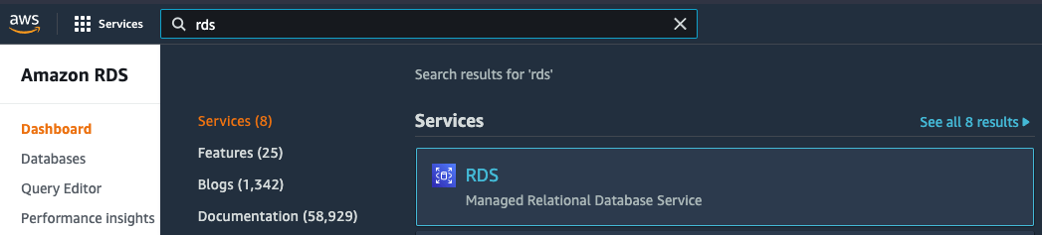
Create Database
* Navigate to RDS :

Slide 4
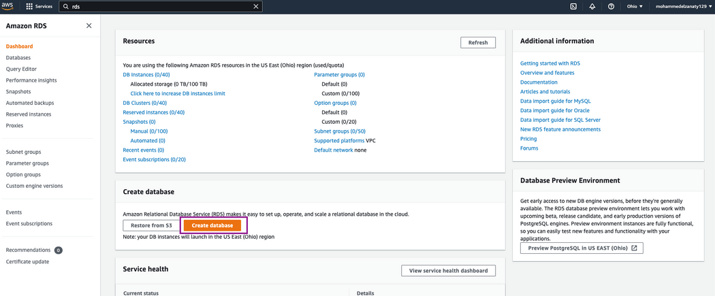
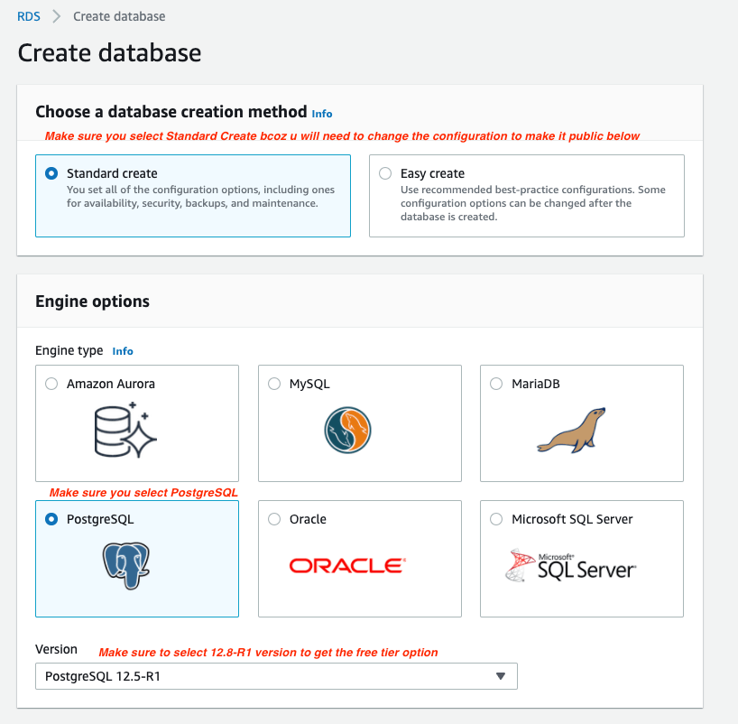
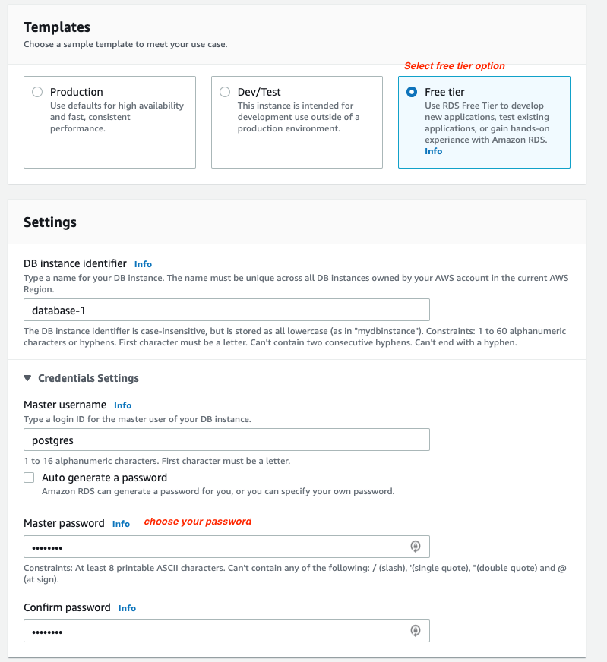
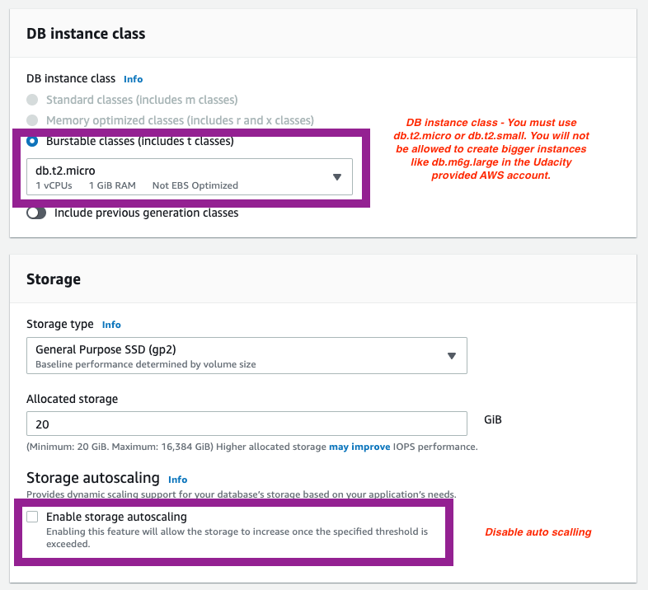
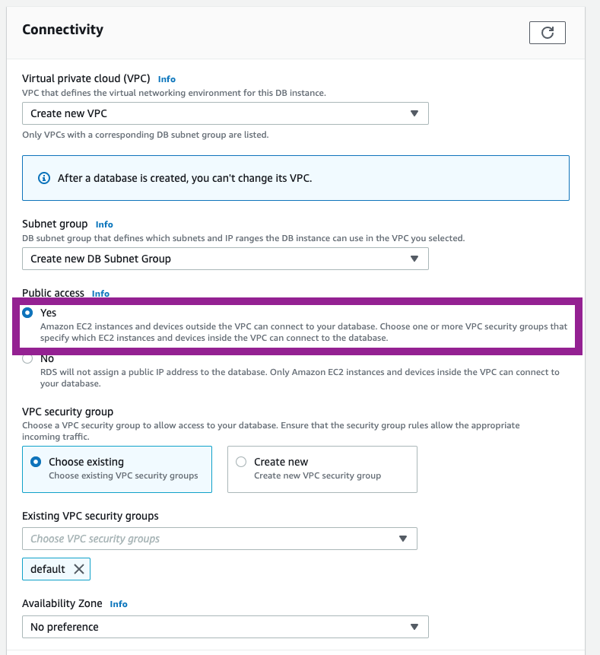
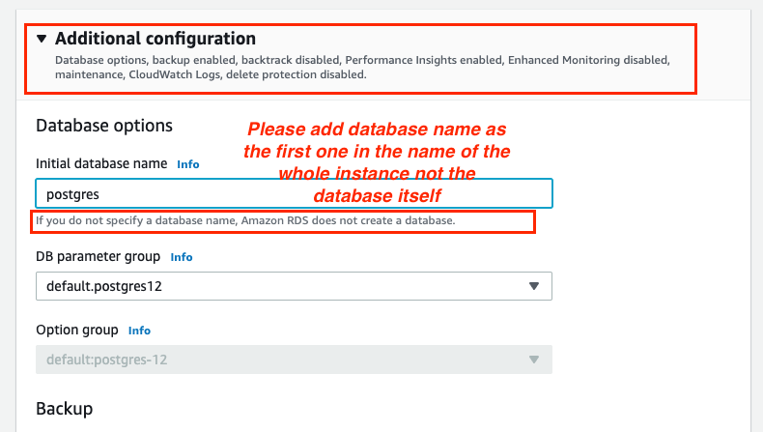
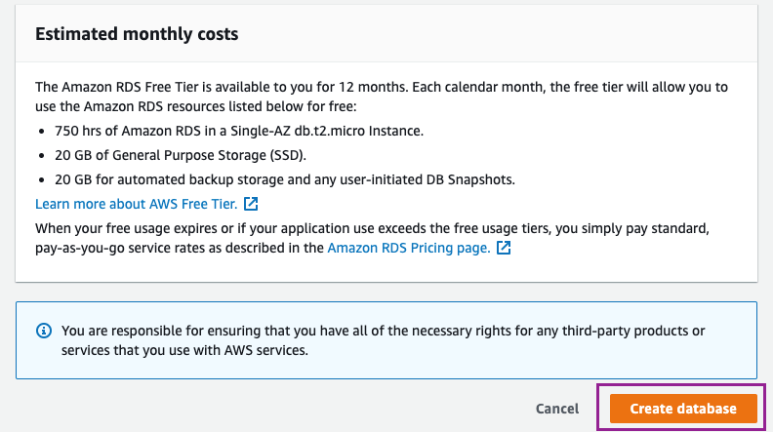
Create Database
* Create Database:

Slide 5
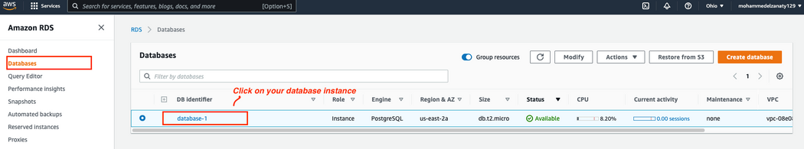
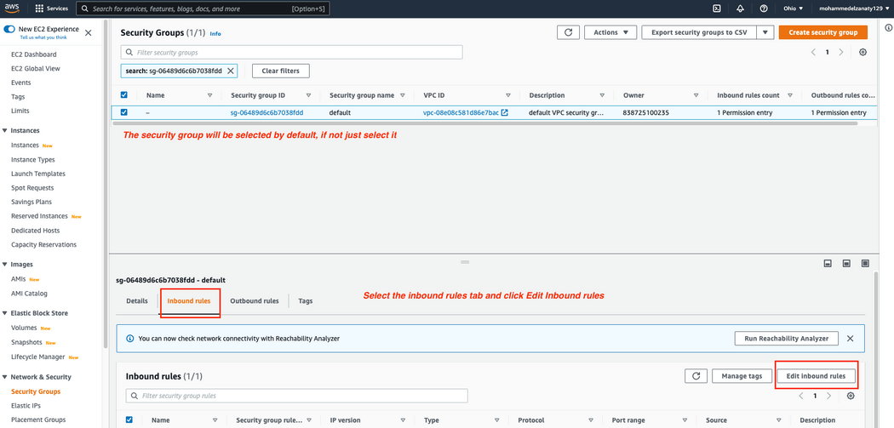
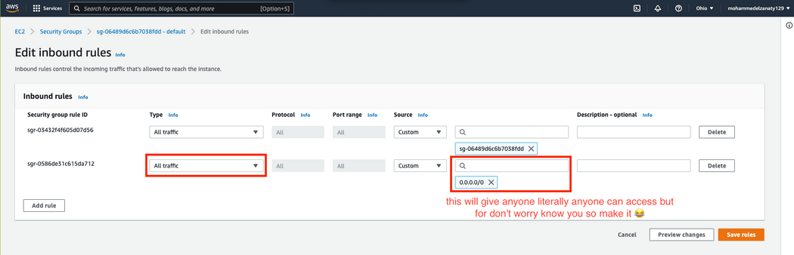
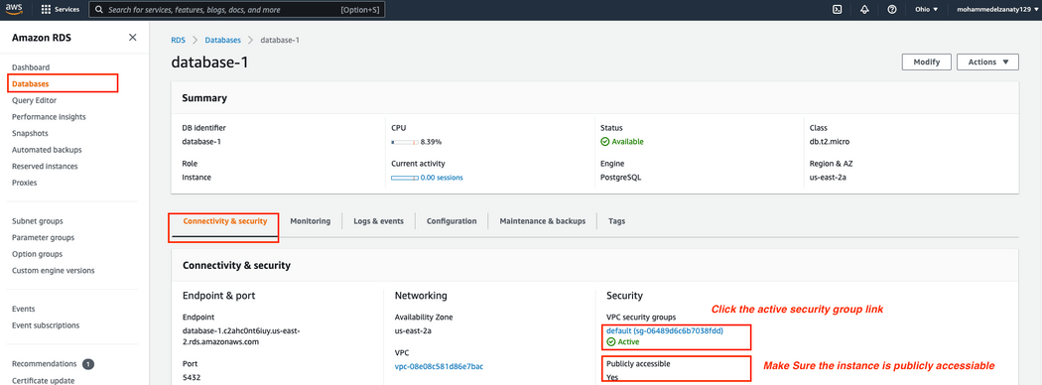
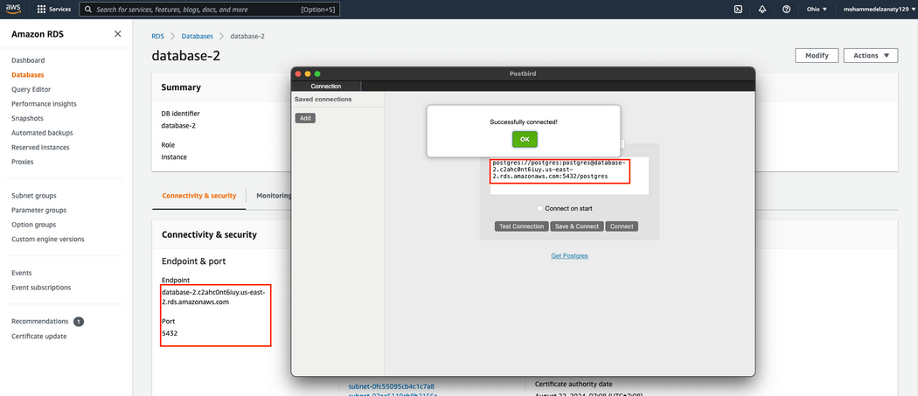
Create Database
* Edit Database & Check Connection:

Slide 6
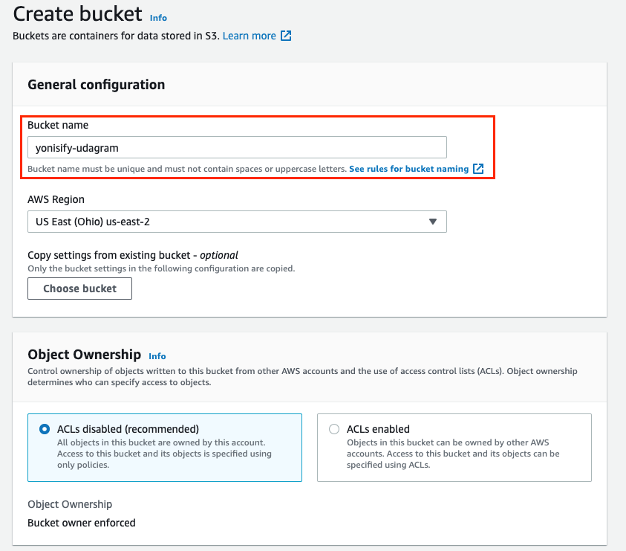
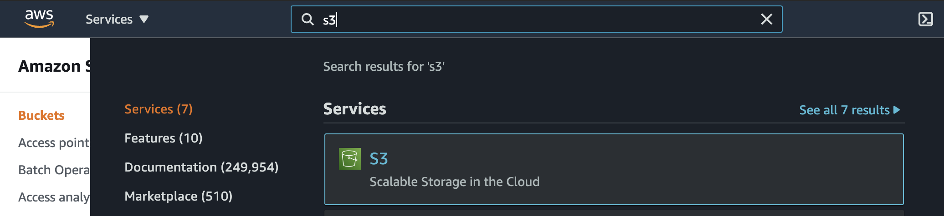
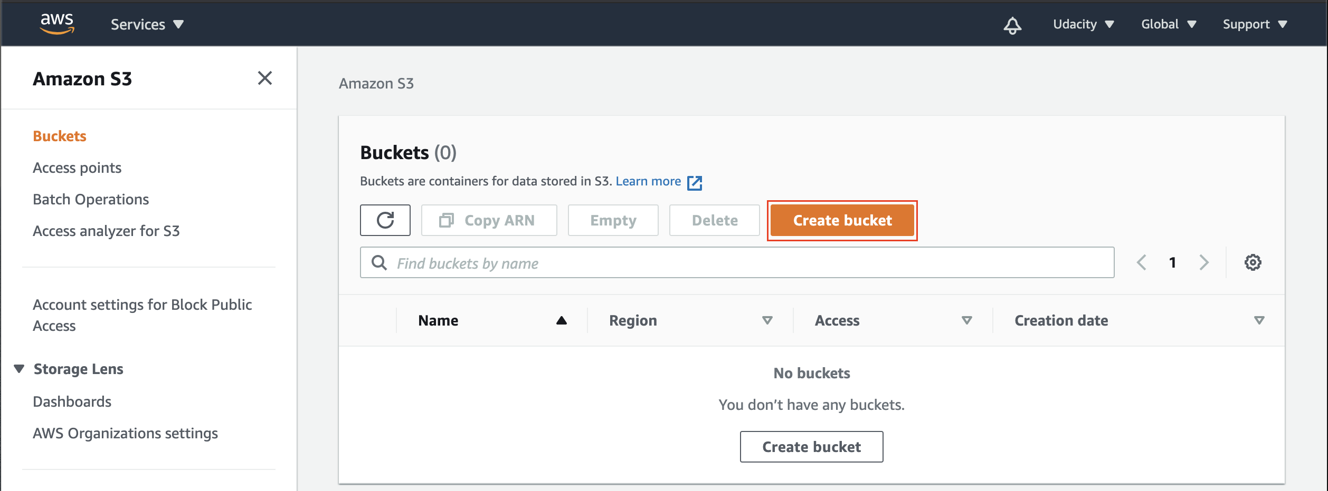
Create S3 Bucket
* Create S3 Bucket:

Slide 7
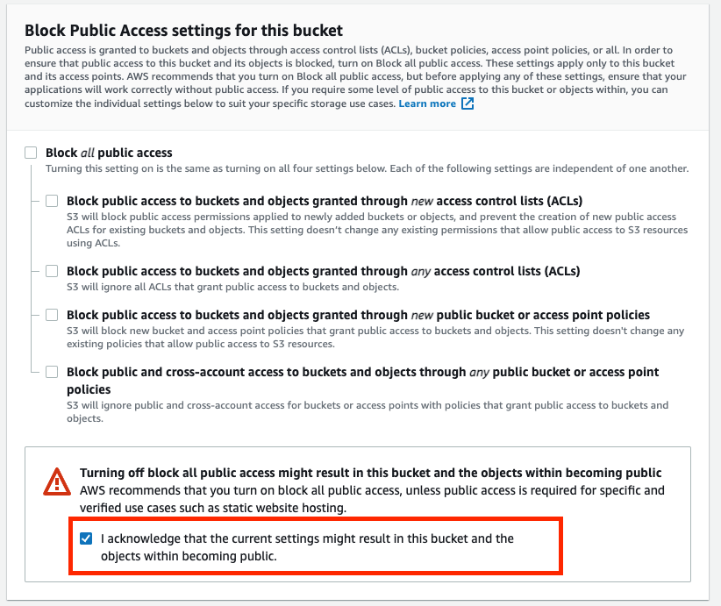
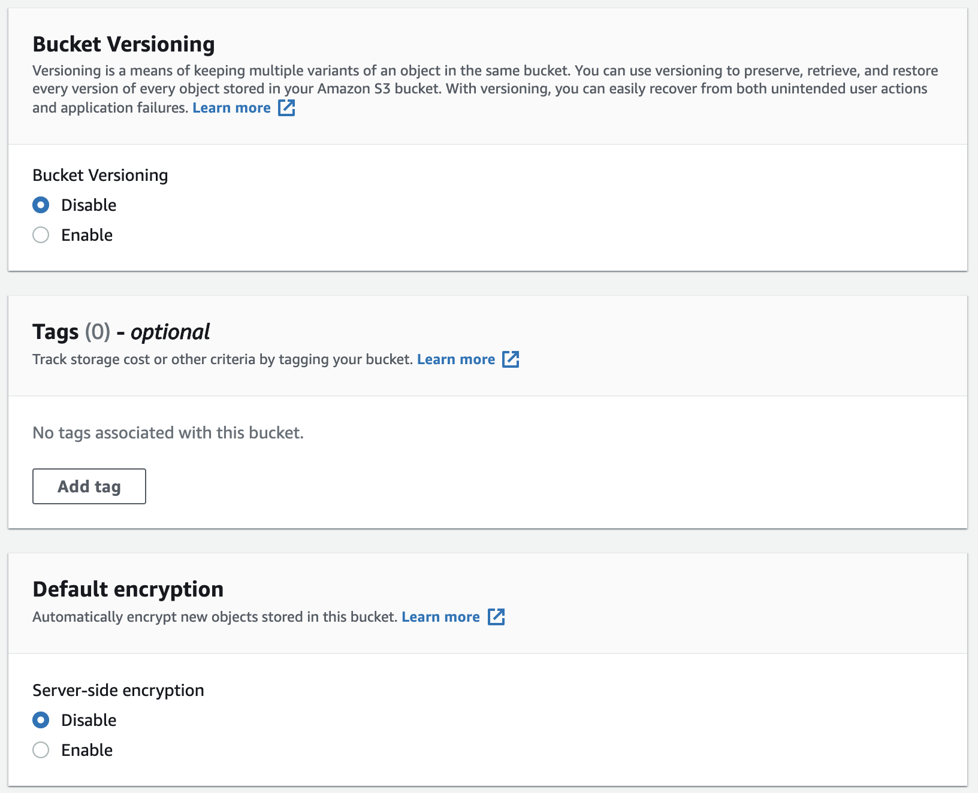
Create S3 Bucket
* Some Configuration in Create S3 Bucket:

Slide 8
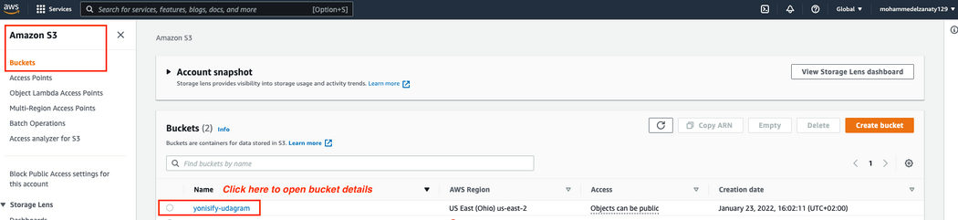
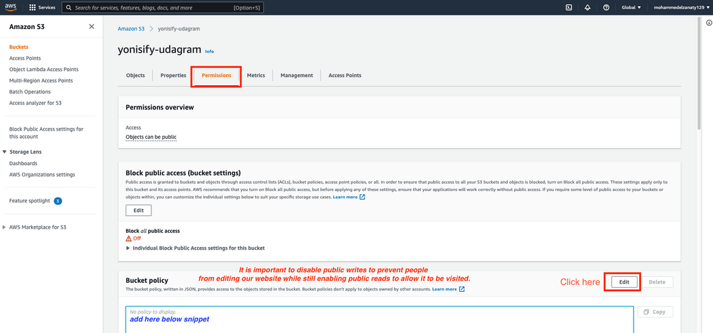
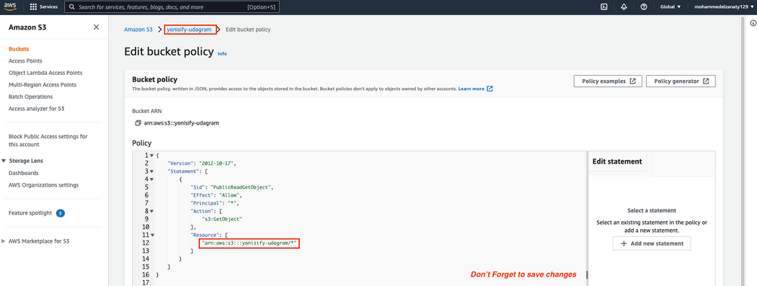
Create S3 Bucket
* Edit S3 Bucket Policy:

Slide 9
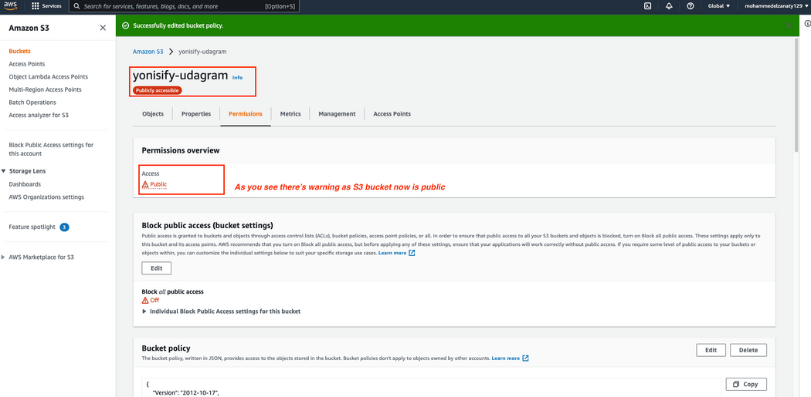
Create S3 Bucket
* Edit S3 Bucket Properties:

Slide 10
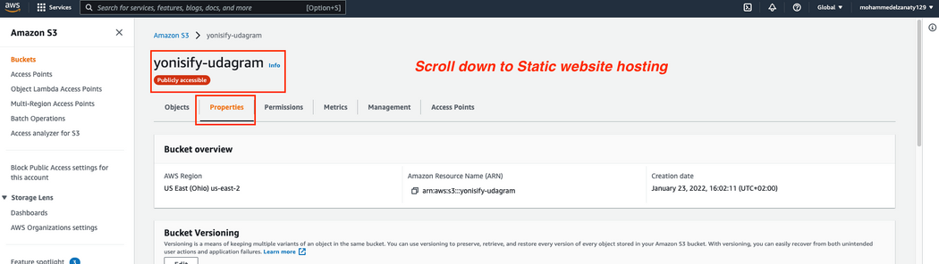
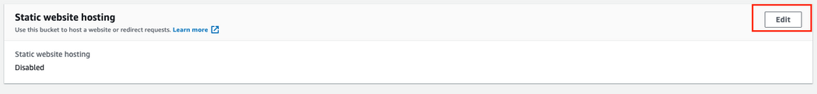
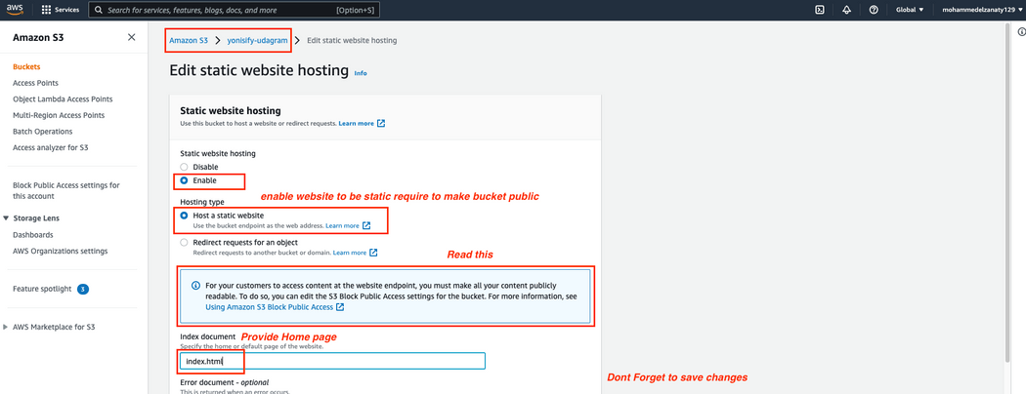
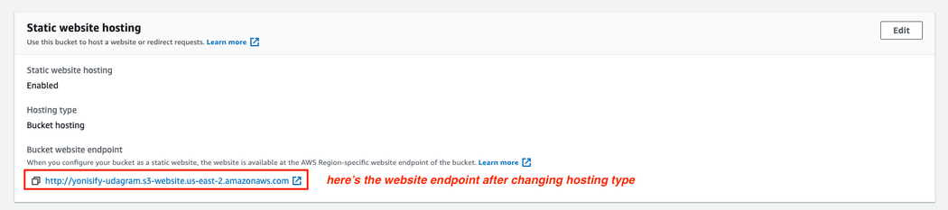
Create S3 Bucket
* Configure S3 Bucket Endpoint:

Slide 11
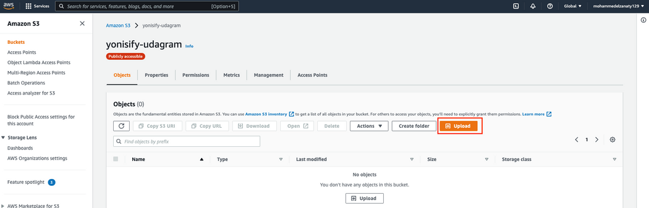
Create S3 Bucket
* Upload Files:
* Upload Files With Terminal or Circle CI:

Slide 12
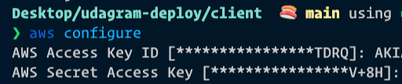
Create S3 Bucket
* AWS Configurations:
But First You need to create IAM user.

Slide 13
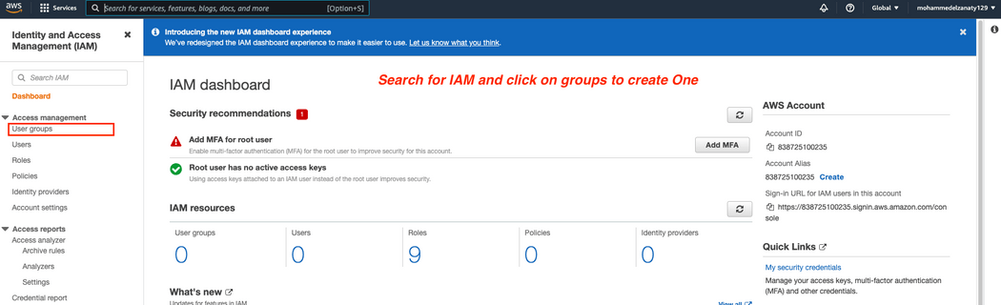
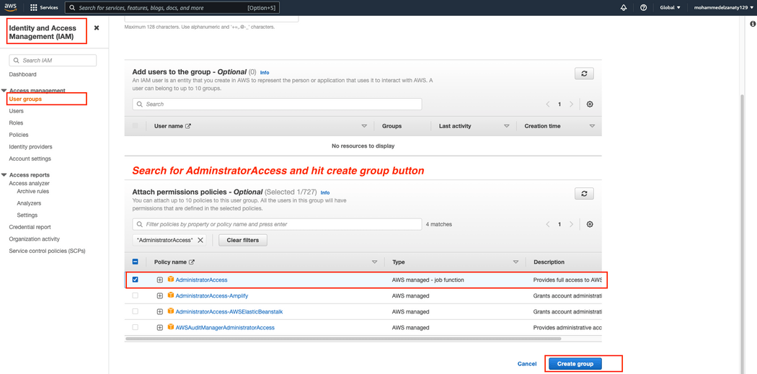
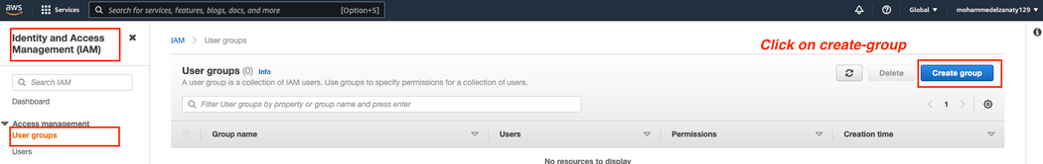
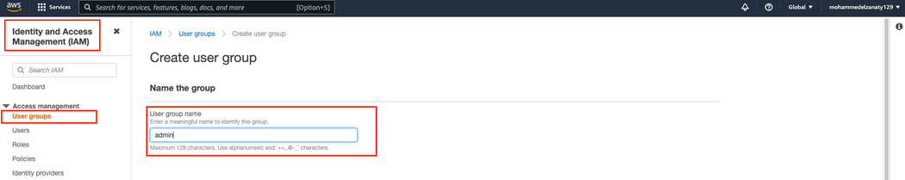
Create S3 Bucket
* Create IAM User:
(Create User Group)

Slide 14
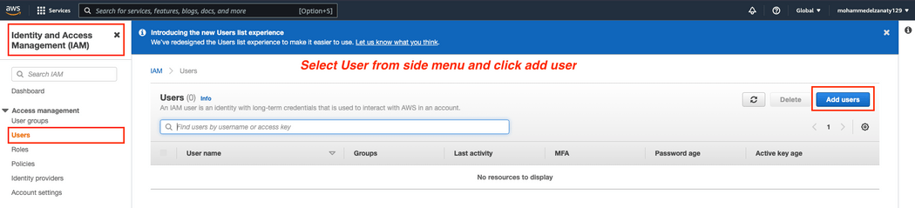
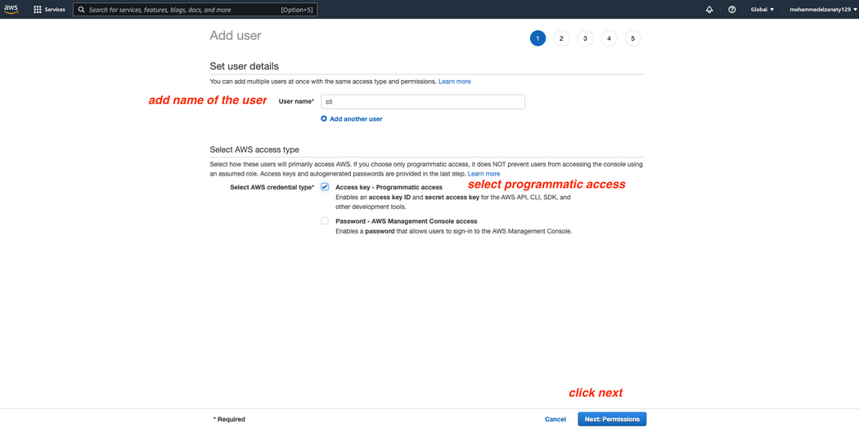
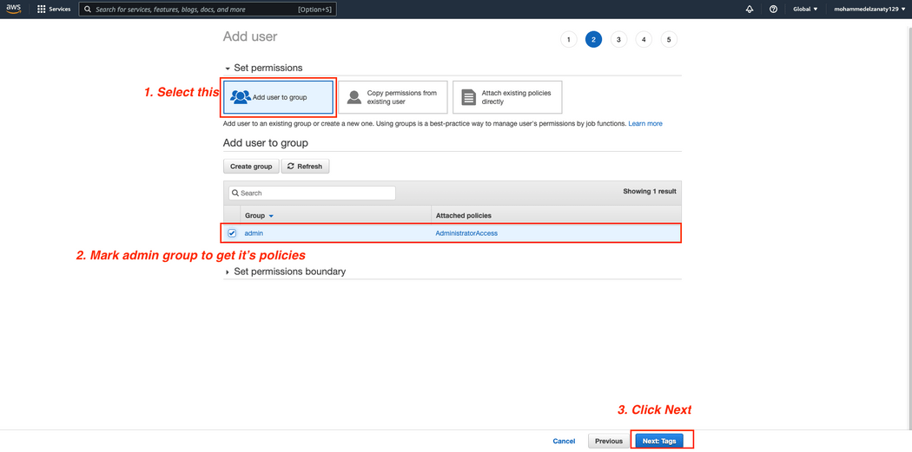
Create S3 Bucket
* Create IAM User:
(Create User 01)

Slide 15
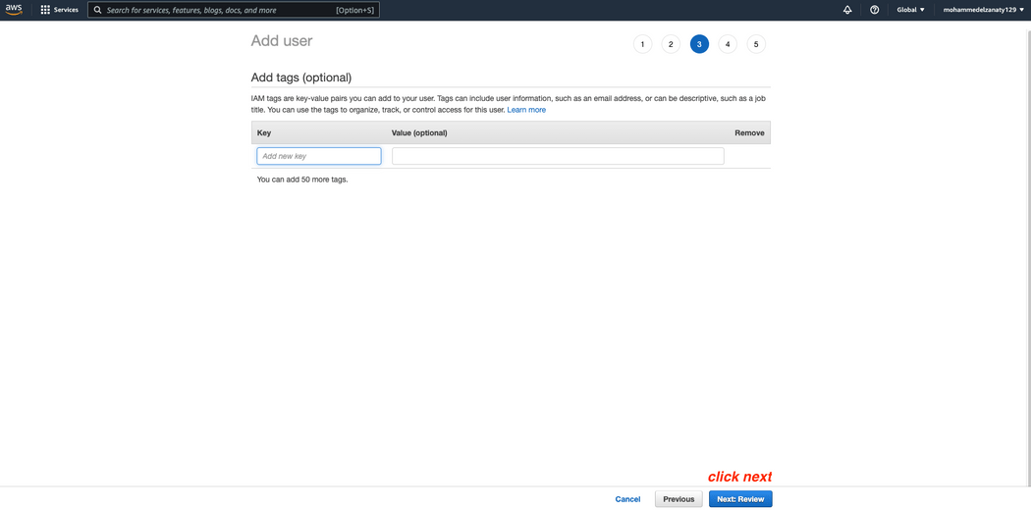
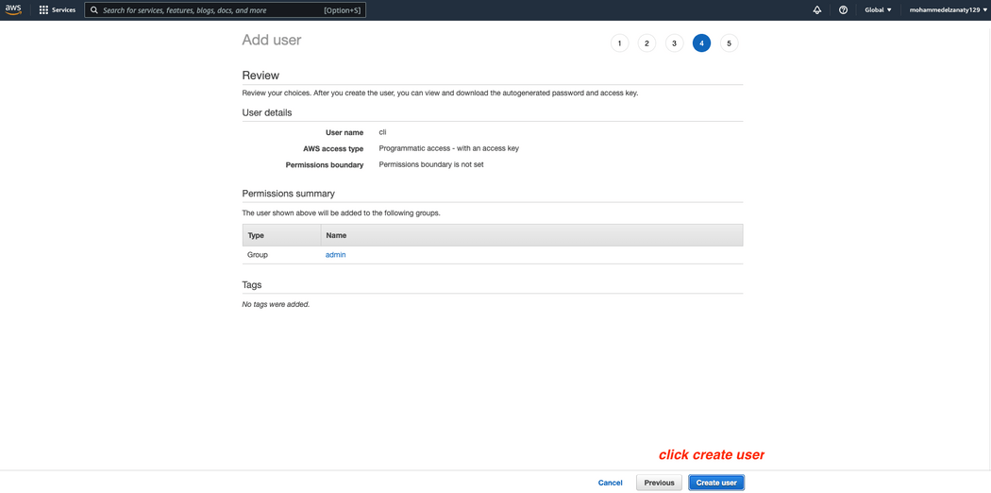
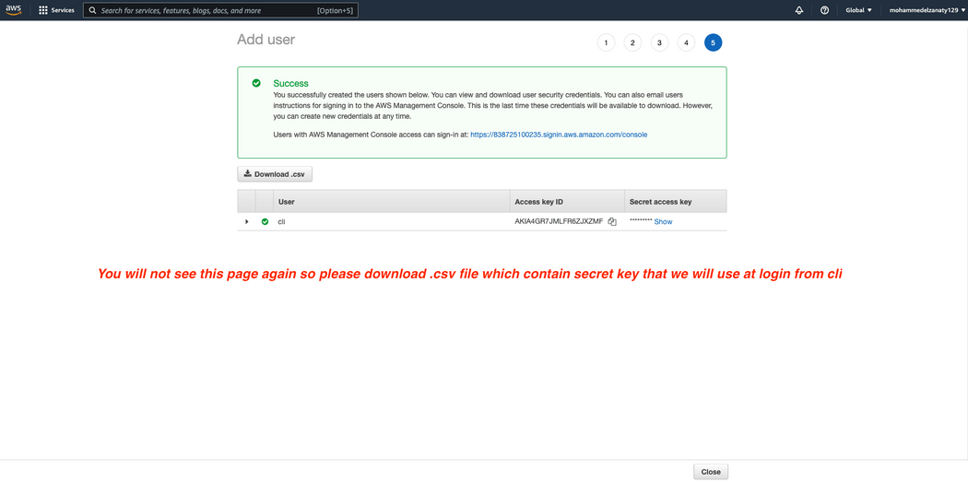
Create S3 Bucket
* Create IAM User:
(Create User 02)

Slide 16
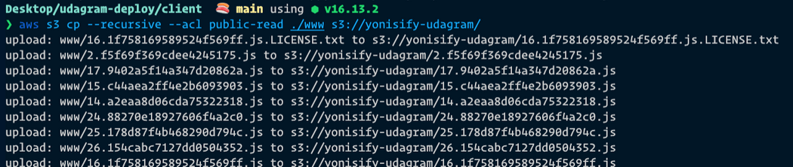
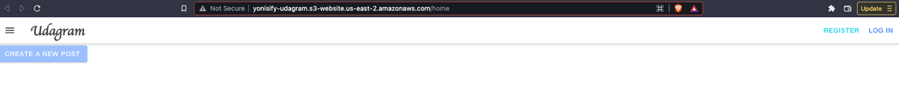
Create S3 Bucket
* Uploading & Check Site:

Slide 17
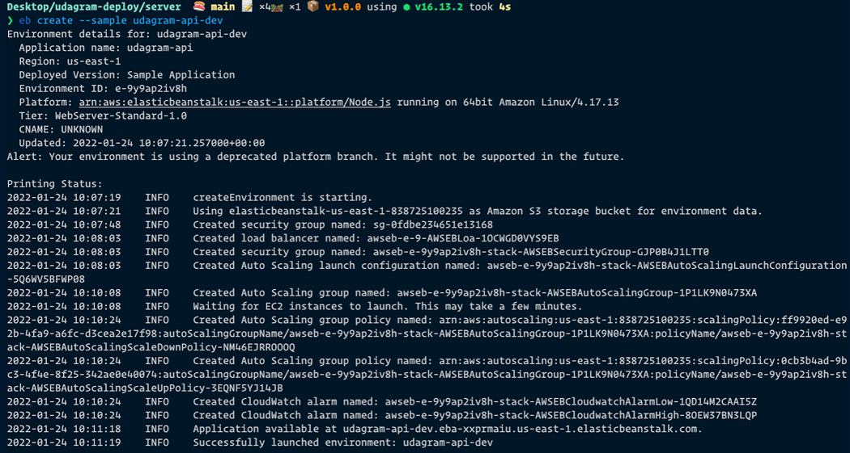
Create Elastic Beanstalk Server
* Create Sample Environment In The Project First:

Slide 18
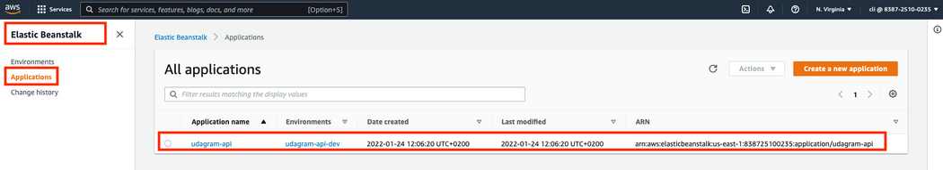
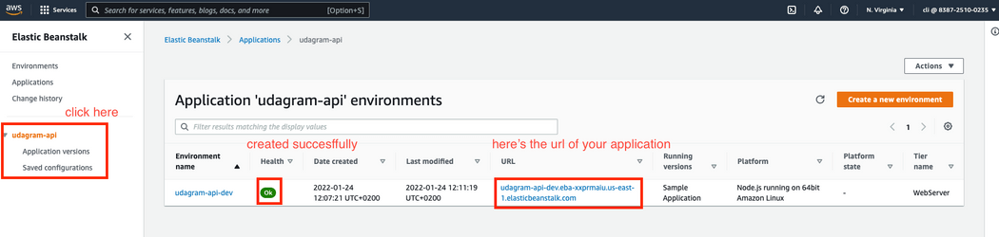
Create Elastic Beanstalk Server
* The Sample Environment In AWS:

Slide 19
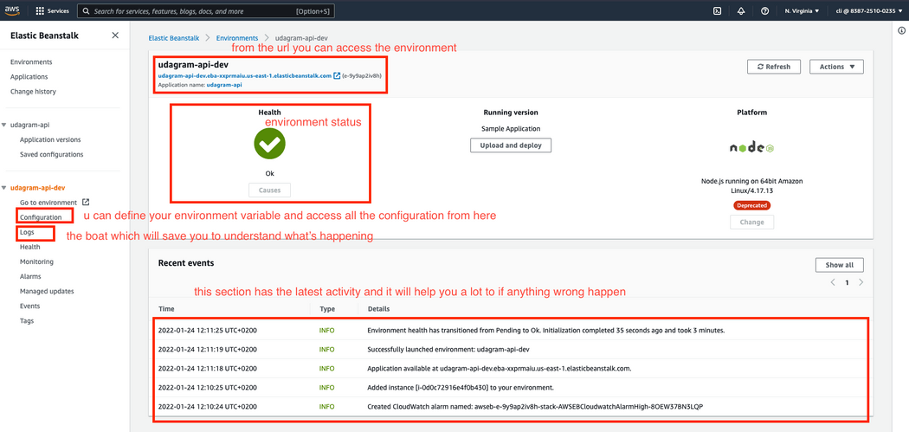
Create Elastic Beanstalk Server
* The Sample Environment In AWS:

Slide 20
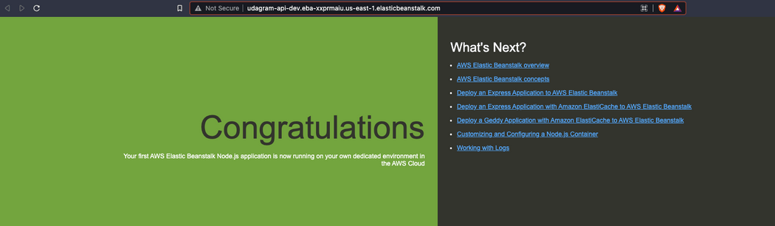
Create Elastic Beanstalk Server
* The Sample Environment In AWS is Working:

Slide 21
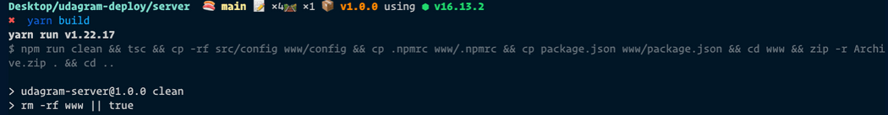
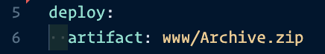
Create Elastic Beanstalk Server
* Deploy Server To EB:
1. Use the environment in the project
2. Build Backend Files
3. Specify The Archive File in Config.yml in Elastic Beanstalk Folder

Slide 22
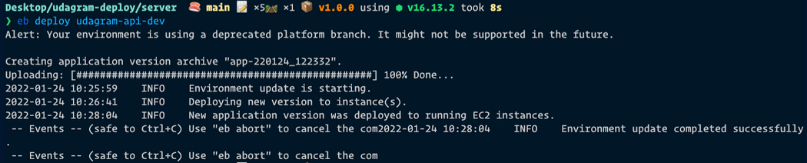
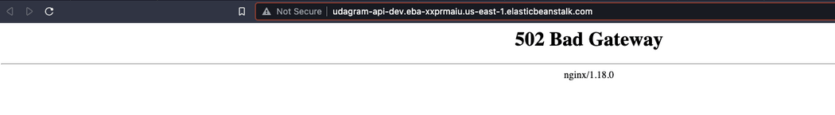
Create Elastic Beanstalk Server
4. Deploy
5. Open

Slide 23
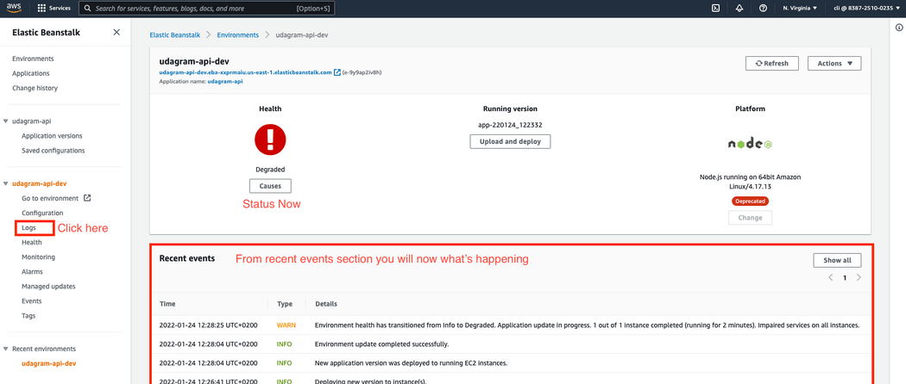


Create Elastic Beanstalk Server
* Check Errors:
* Set Environment Variables:

Slide 24

Create Elastic Beanstalk Server
* Then Build Again & Deploy Again:

Slide 25


Create Elastic Beanstalk Server
* Refresh The Environment Automatically After Upload:

Slide 26


Create Elastic Beanstalk Server
* If You are Done >> Terminate Environment:

Slide 27
APP DEPENDENCIES

Slide 28


APP DEPENDENCIES
* Front End
* Back End

Slide 29


APP DEPENDENCIES

Slide 30
PIPELINE PROCESS

Slide 31

PIPELINE PROCESS
* Create Account on Circle CI and Connect it with your GitHub Account:

Slide 32

PIPELINE PROCESS
* Specify The Config.yml File From Which Branch:

Slide 33

PIPELINE PROCESS
* Project Dashboard:

Slide 34

PIPELINE PROCESS
* Setup Environment Variables:

Slide 35

PIPELINE PROCESS
* Setup Environment Variables:

Slide 36

PIPELINE PROCESS
* Deployment Process Status:

Slide 37

PIPELINE PROCESS
* Error in Deployment Process:

Slide 38

PIPELINE PROCESS
* Deployment Process Succeed:

